Slide 1
Using the Power of Habits for Real Change
Jennifer Nelson
Education Coordinator
Sustainability Program
Washington County
sustainability@ co.washington.or.us
503-846-8825
Notes:
Hello! Introduce myself.
Before we get started, I wanted to touch base on our reasons for being here.
You might answer yes to both of these, that’s ok…
By a show of hands, how many of us are here today to learn how to change our own habits?
By a show of hands, how many of us are here today to learn how and why to teach others to change their habits?
I will tailor the focus and timing based on this response level.

Slide 3
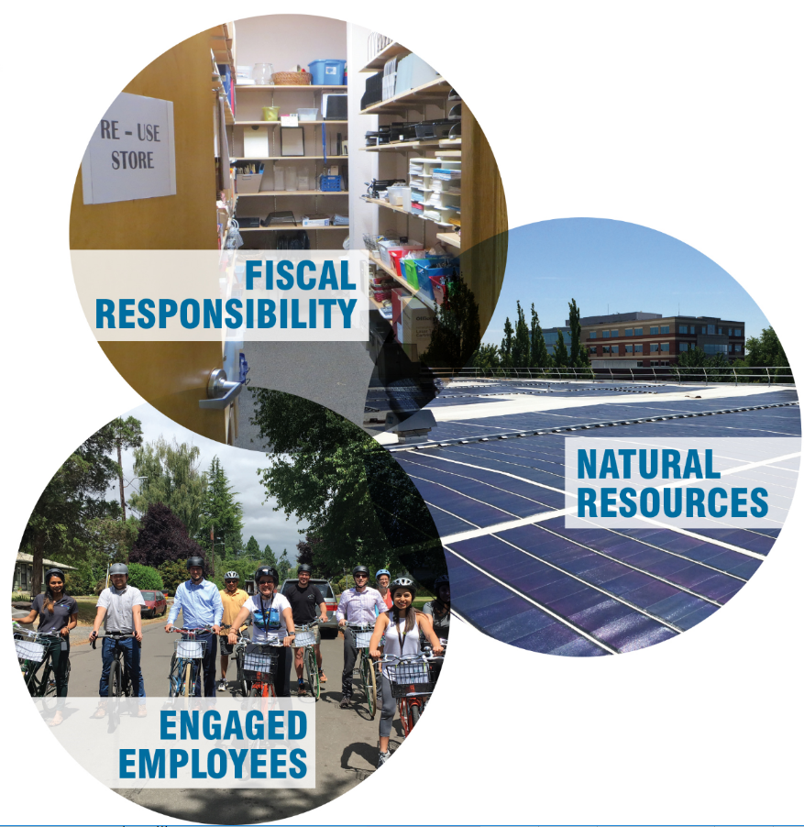
Measure | 2018* Goal | 2017 Achievement
Building Energy | 20 percent ▼ | 27 percent ▼
Water | 2 percent ▼ | 11 percent ▼
Recycling | 50 percent ▲ | 14 percent ▲
Garbage | 25 percent ▼ | 18 percent ▼
Materials Recovery Rate | 50 percent | 37 percent
Fleet Fuel | 8 percent ▼ | 18 percent ▼

Slide 4
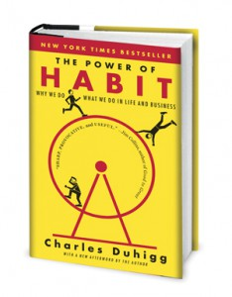
The Power of Habit
Notes:
This presentation is based on the excellent book, the Power of Habit, by Charles Duhigg, along with some additional resources. This book is available at our local libraries in print and on audio CD. The book covers much fascinating information from the worlds of psychology, medicine, marketing and business management that we just don’t have time to cover here today and I highly recommend giving it a read.
WTA and I will work together to provide you today’s slides, a link to a reader’s guide for the book, and electronic copies of these worksheets. If you are an educator and would like the PowerPoint version of the presentation to edit and reuse, please email me. I only ask that in doing so, you include a brief slide in your presentation acknowledging Duhigg’s copy-righted work and my original presentation.

Slide 5
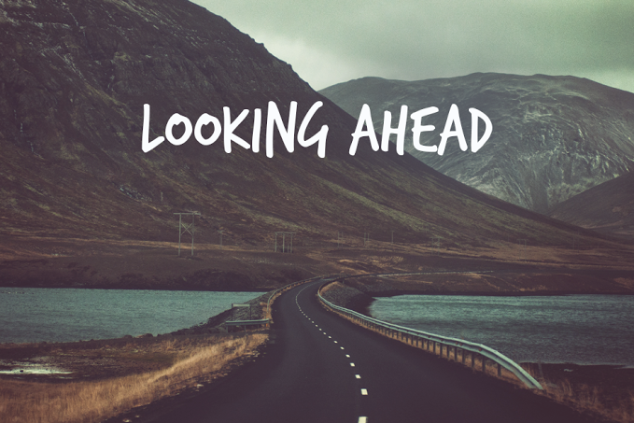
What do educators do well in training? What are the pitfalls?
What are habits and can we change them?
What habits do we want to change?
What’s the key to successful habit change?
What are the best tools to help us on the way?
Notes:
Today, we will discuss what makes a habit and how it can be changed. We will be working through a worksheet as we go along that provides you with an outline of habit changing tactics too!

Slide 6
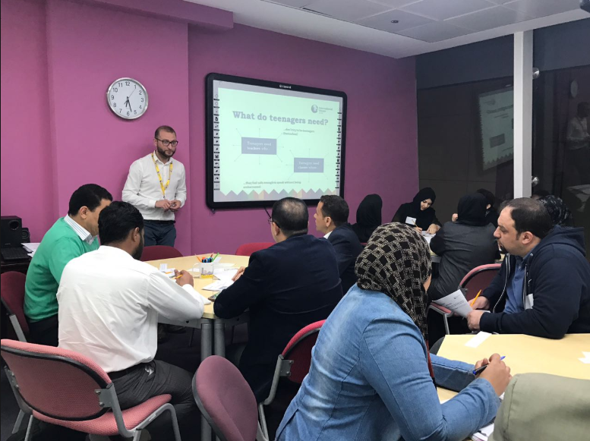
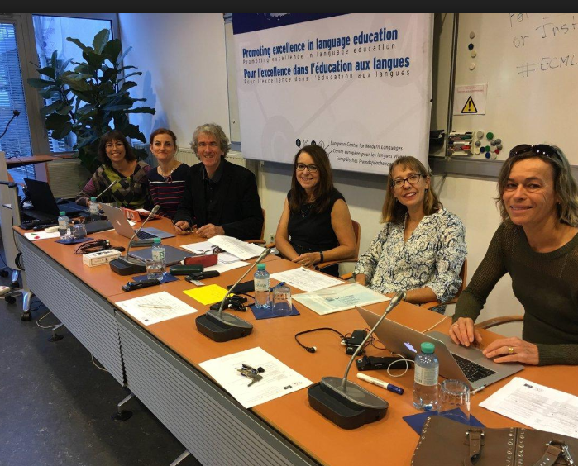
How do “experts” like us usually teach?
Notes:
Discussion.

Slide 7
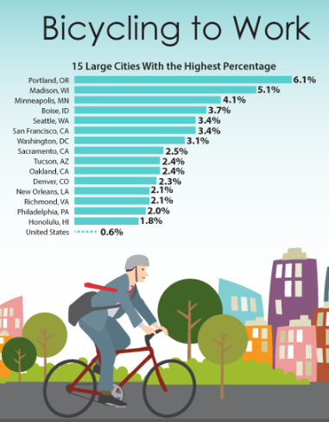
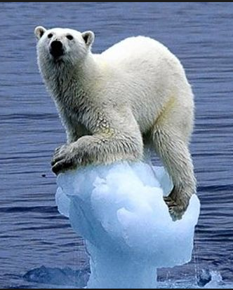
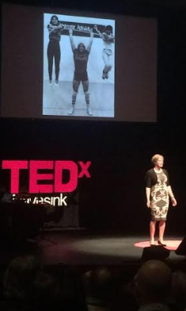
Raising awareness & concern to motivate
Notes:
We often start by seeking to raise awareness and concern to help motivate people to act. This comes from an intuitive understanding, backed by educational theory and practice, that we change what we care about, and that change is hard, requiring strong motivation. We might use a variety of techniques to raise awareness: sharing statistics, shocking images, motivational stories. All are designed to play into the learning styles and values of our audience, and are best used in combination with one another. By mixing visual, auditory and experiential learning styles with different types of content: data, examples, stories, logic models, etc., and touching on a variety of values such as protecting the environment, enriching the welfare of future generations, or saving money, we are able to connect with a room full of strangers at a memorable and motivating level.
https://www.census.gov/content/dam/Census/newsroom/releases/2014/cb14-86_graphic_biketowork.jpg

Slide 8
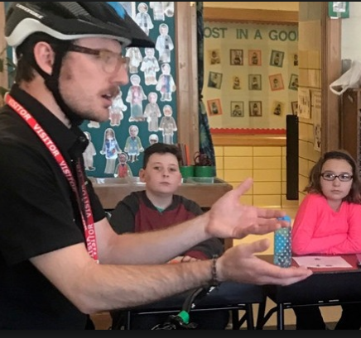
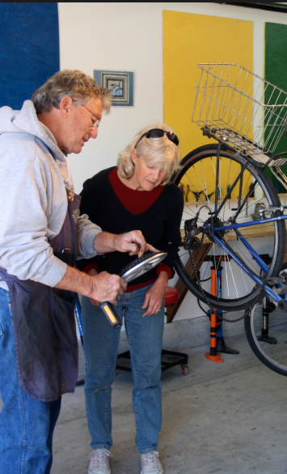
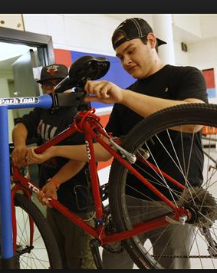
Instruction on skills & practices
Notes:
Once we have people aware and motivated to make a change, we usually teach them how to make the change or what they can do that is the better choice. This is done through telling, demonstrating and sometimes even engaging learners to do it themselves. We might invite discussion, role playing, or brainstorming to engage the learners with the materials for better retention. I’ve even taught some classes where we start on planning how the person will make the change – what materials need to be bought, what changes need to be made, and so on. Participants might take home a work sheet or book to help them further.

Slide 9
“Tell ‘em what you told ‘em.”
Notes:
Usually, educators of all types wrap up a workshop with a review to help retention. We go over, briefly, what was learned during the workshop in terms of motivation and skills. We answer questions people have to help clarify. We suggest resources to follow up with or next steps. This is often followed up with a survey about the workshop, in which learners rate the learning experience based on what happened in the classroom. Less frequently, educators might follow up with students to see what was retained days or weeks later; rarer still is the practice of following up on the behavior change the workshop was meant to inspire and teach.

Slide 10
So, does this work?
Notes:
Usually, educators of all types wrap up a workshop with a review to help retention. We go over, briefly, what was learned during the workshop in terms of motivation and skills. We answer questions people have to help clarify. We suggest resources to follow up with or next steps. This is often followed up with a survey about the workshop, in which learners rate the learning experience based on what happened in the classroom. Less frequently, educators might follow up with students to see what was retained days or weeks later; rarer still is the practice of following up on the behavior change the workshop was meant to inspire and teach.

Slide 11
Notes:
This form of teaching through raising awareness and building new skills apparently works to some extent -
The Shelton Group compiled some interesting figures on what American’s think, feel and do when it comes to sustainability. We can see from these figure that American’s think and feel that caring for the environment is very important… 88% of us think that reducing environmental impact is everyone’s business, not just for scientists or environmentalists. And 78% feel a personal responsibility in this regard.
https://sheltongrp.com/insights/sustainability-consumer-loyalty/

Slide 12
And yet…
Notes:
But many still struggle to change behaviors related to the environment. And this isn’t the only area in which our actions don’t always match up to our beliefs. Behavioral scientists have researched many areas where thoughts, beliefs and actions don’t match up, from how we spend our money and what we chose to eat, to how we behave in our most important relationships.
Why is it difficult for you to change behaviors that you think and feel you ought to?
https://sheltongrp.com/insights/sustainability-consumer-loyalty/

Slide 13
What are educators missing?
Notes:
Usually, educators of all types wrap up a workshop with a review to help retention. We go over, briefly, what was learned during the workshop in terms of motivation and skills. We answer questions people have to help clarify. We suggest resources to follow up with or next steps. This is often followed up with a survey about the workshop, in which learners rate the learning experience based on what happened in the classroom. Less frequently, educators might follow up with students to see what was retained days or weeks later; rarer still is the practice of following up on the behavior change the workshop was meant to inspire and teach.

Slide 14
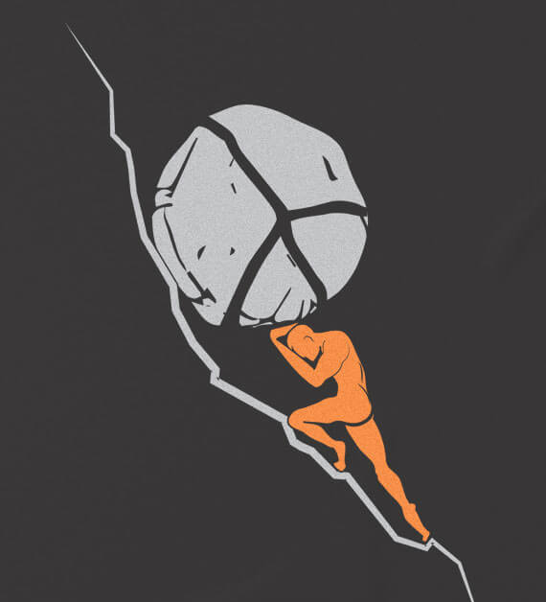
Knowing Isn’t Enough
Generally, we might…
Lack motivation to change
Struggle to translate knowledge to action
Face some existing bad habits already
Work hard to maintain new choices
Notes:
Think about the various presentations you’ve seen over the years, urging you to donate money, stop doing something that harms your health, or try something new to help the planet. I’d bet you that most of these presentations really focused on the facts and stories of the issues. The presenter wanted you to know about the problem, believe it was a problem, and care about changing it. I’d also be willing to bet that, most of the time, you didn’t follow through on that change despite knowing about, caring about and believing in the problem. It’s happened to me countless times, both as the presenter and as an audience member. Ever wonder why?
“…research [in the health behavior change field] repeatedly shows that people are reluctant to recognize personal risks and are overconfident about their own invulnerability to health problems. Further, people lack sufficient motivation to change their habits, they frequently fail to translate healthy intentions into action, their efforts are undermined by the persistence of prior unhealthy habits, and they have considerable difficulty maintaining new healthy patterns of behavior.”
https://www.psychologicalscience.org/publications/observer/obsonline/helping-healthy-habits-stick.html

Slide 15
Some tools we can use…
Facilitated Adult Learning
Self led
Learning
Styles
Experiential
Habit Change
Highly applied
Draws on their existing knowledge
Kinesthetic
Multiple intelligences
Community Based Social Marketing
Identify & understand behavior
Identify benefits
& costs of existing &
new behavior
Work with social norms & diffusion
Applicable to multiple practices
Highly adaptable
Highly realistic & individualized
Notes:
There is a tendency to educate adults as we were once educated as children, and this makes sense as much of the educational theory out there is designed for primary and secondary education. Life long adult learners, however, are a bit different. We bring our own experiences and knowledge to the table. We have opinions and frameworks for thinking about the world already in place. We have patterns and habits already engrained. This diagram shows some of the tools that I use in designed adult education to change sustainability actions at work, including focusing on habit change.

Slide 16
Why be so general?
Motivation
Retention
Impact
Community Based Social Marketing
Notes:
Usually, education is highly targeted at one specific behavior to change. Today I am going to teach you how to change a transportation habit of your own using a more general tool. It is a skill you can teach others using the tools here, and one that they can use to change any habit they want, whether or not it is related to sustainability or transportation choices. I choose to add this approach to my training portfolio for several reasons (listed on slide – go through them)…
Motivation: we were running into challenges with learners who didn’t feel motivated by the usual sustainability at work values – by training on a practical skill like how to change any habit, we were able to engage their general personal interest and weave into it take home messages about sustainability.
Retention: Adult learners are busy, distracted and oftentimes overwhelmed by information, especially in the workplace. Providing them with a new tool that they can apply and practice where it is most meaningful to them has helped to cut through the clutter.
Impact: By training employees on how to make a change, we enable them to make future changes – knowing how to change a habit successfully makes all of our trainings on transportation, waste reduction, energy use and other topics that much more effective.

Slide 17
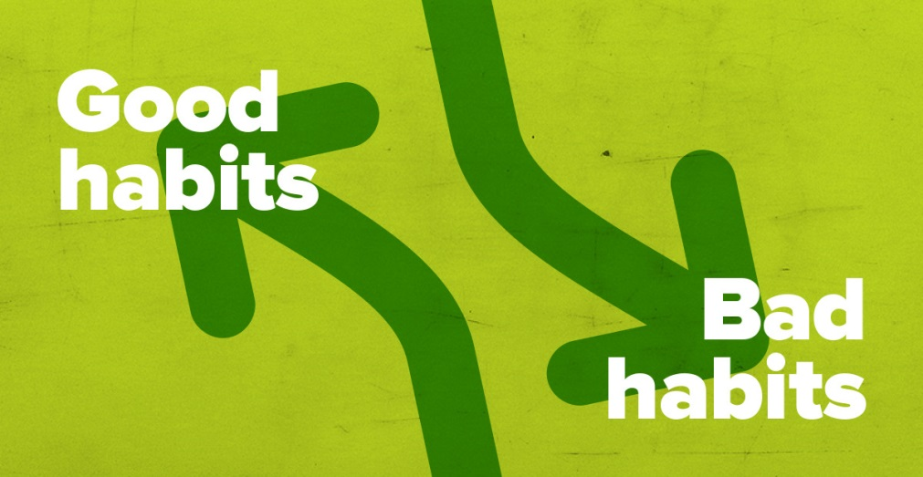
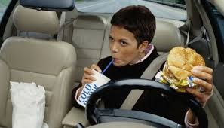
What are habits?
What are some of the habits that you have?
Notes:
The key, really, to much of the discrepancy between what we value and what we do lies in how habits form our day to day actions without us even knowing this is going on.
Here are two of my habits: I used to have a bad habit of eating fast food in the car and occasionally now I will relapse. I have a great habit of calling my mom on the weekends.

Slide 18
What are habits?
A habit is a pattern of behavior
It occurs at a sub-conscious level
As you know, they can be very hard to change!
Notes:
Discuss text of slide

Slide 19
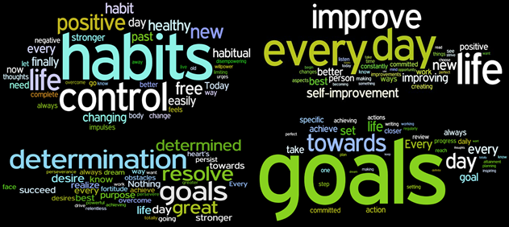
What habits aren’t
Notes:
It’s important to dispel some of the myths we have about what habits are. The word clouds here were gathered from websites that encourage positive habit change. You can see, though, that not all of the words used to discuss habits are positive and health. Habits can be viewed in a positive or a negative light, but they are almost always portrayed as reflecting your character. This language around habits can have serious consequences for your self image and mood, especially if habit change is challenging for you. As we will see, changing habits isn’t about your strength of character at all…

Slide 20
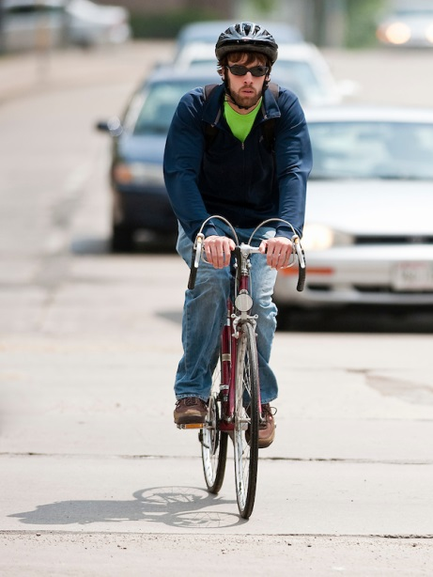
Why Do Our Habits Matter?
Notes:
Our habits both at work and home can have significant cumulative effects on the environment. All day, we take small actions that we don’t really think about but have become routines. Those actions don’t seem significant enough to spend energy thinking through each time – and we don’t really have the time and energy to do so either. Habits help us get through our days productively and have time for the things that really matter. But small actions also add up over the day, week or year, or across our organization or community.

Slide 21
Good news!
"What we know from lab studies is that it's never too late to break a habit. Habits are malleable throughout your entire life. But we also know that the best way to change a habit is to understand its structure — that once you tell people about the cue and the reward and you [help] them to recognize what those factors are in a behavior, it becomes much, much easier to change.“ – Charles Duhigg
Notes:
The good news is that, once your awareness has been raised, once you know the ways in which you can change something, and once you have decided you are ready to make that change, ANY habit can be changed at ANY time, provided you know a few tricks.
https://www.npr.org/2012/03/05/147192599/habits-how-they-form-and-how-to-break-them

Slide 22
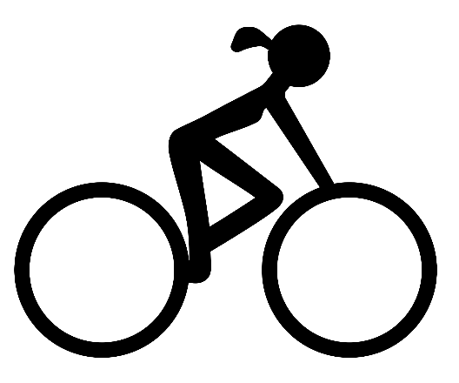
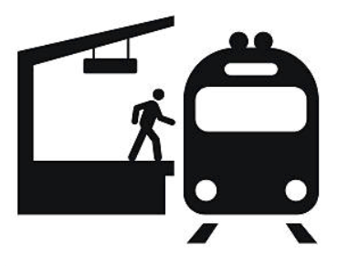
So start changing a habit… TODAY
Change part or all of your commute
Run one errand a week by foot or bike
Try carpooling to the beach or ski slopes
Increase the days you commute actively
Use more than one mode of transportation to get to sporting events
Choose your own adventure!
Notes:
Hand out worksheet
The model you will learn today can help to change any habit, even habits that seem too big to change. To help us understand how it works, though, let’s start with just one small habit related to sustainability at work. There are a few ideas here, but feel free to chose your own. Pick something that will be easy to change.
Please know that I am going to ask you for a lot of participation and sharing from this point forward. It will always be optional but you will get the most out of this workshop by sharing what you are working on, asking others for advice, and raising questions when you aren’t sure. I’ll also be coming around to offer help during the individual work sessions. So I recommend picking something that isn’t too private for your to share, or letting me know that you’d prefer not to be asked to share at all.
The worksheet provided to you summarizes all of the steps we will talk about here today. Please use it to make notes on your intentions to change the habit you select today throughout the workshop.
I’d like you to get started now by using the first two lines. What habit do you want to change? What motivates you to change that habit?
Ok – what are some of the habit we decided to work on?

Slide 23
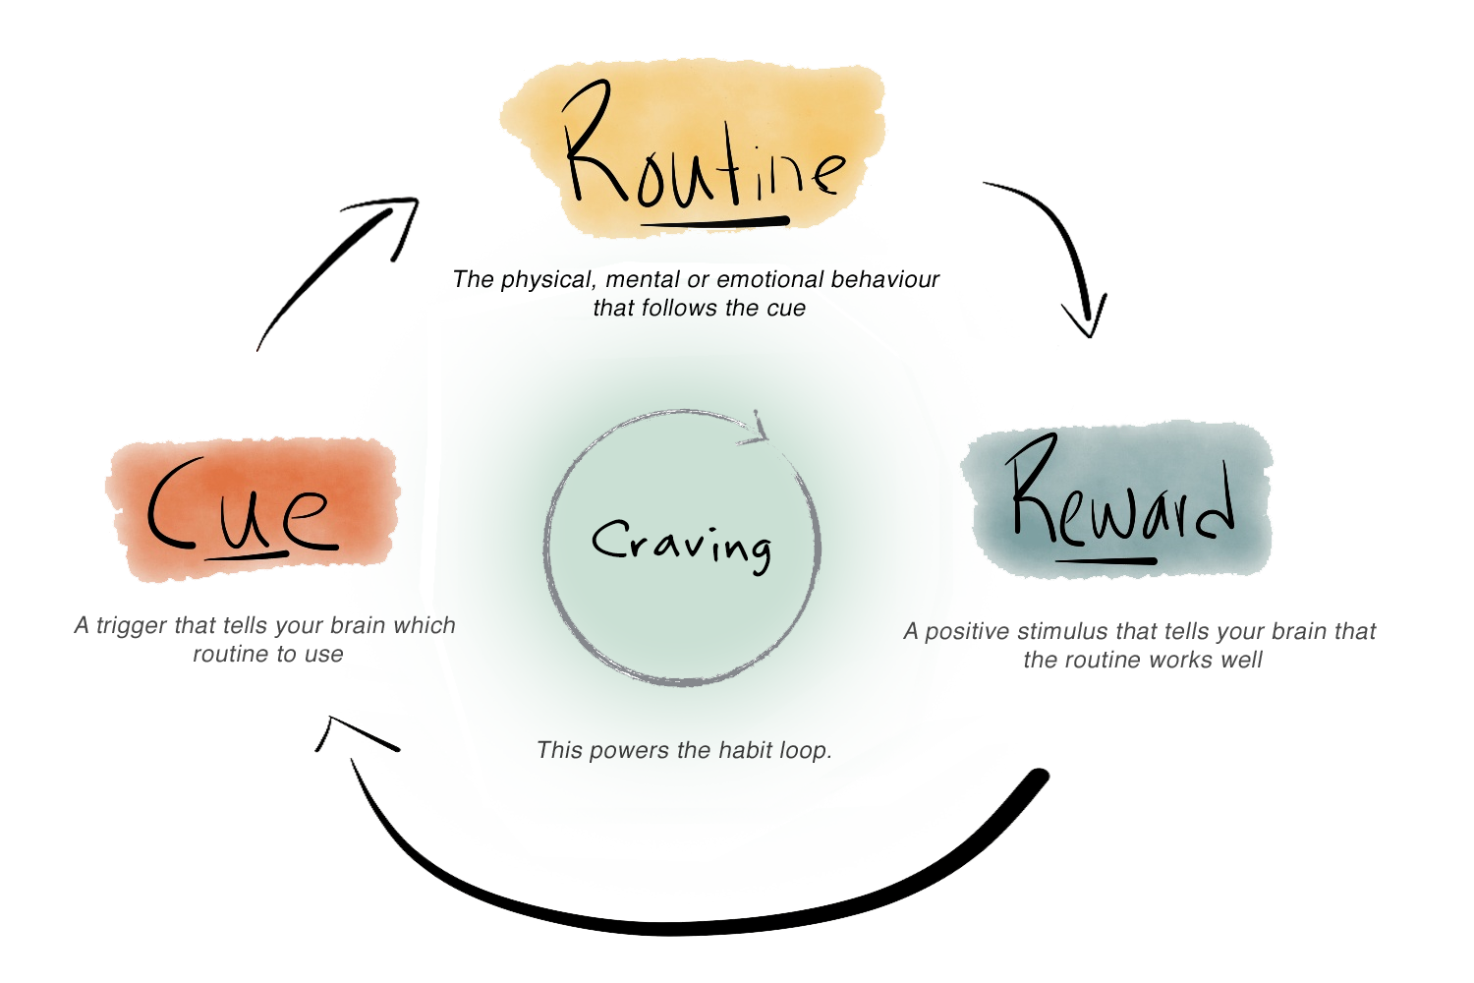
The Habit Loop
The cue and the reward shape the final outcome.
Notes:
Psychologists have identified 4 main components of a habit: the cue, routine, reward and craving. Changing a habit requires us to understand how this loop works. We can also use an existing habit to help start new ones by taking advantage of this same loop.
Most people focus on the routine behind the desired habit, but it's actually the cue and the reward that shape the final outcome. Focusing on behavior alone is why resolutions fail. Let’s walk through each part of the habit loop together.
If you selected an existing habit to change, you can follow along on the worksheet and identify each of these steps as we go. If you selected a new habit to start, we will address that a little later on.
Text from the reading guide. Image from https://www.mindful-company.com/blogs/notebook/a-mini-guide-to-forming-habits

Slide 24
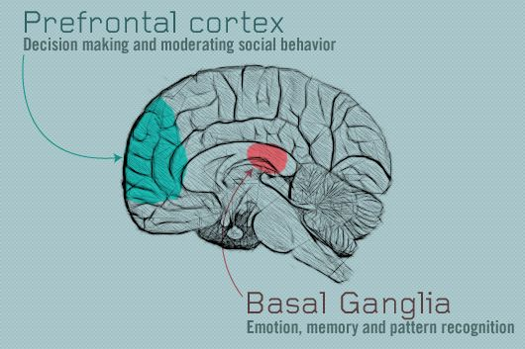
What’s Happening in the Brain?
https://www.pinterest.com/pin/51017408257048600/
Notes:
One thing I enjoyed about the book was learning how my brain works to make this loop happen. We will get into a little biology here, so hang on with me while I geek out just a bit. Our brains have two ways of processing most of the actions we take each day. The first time we do something, we usually have to think it through. Think about a new skill that you learned some time in your life. Like tying your shoes. You had to focus very closely on the directions for doing this. It took some practice to get it right the first time, and then some more practice to remember it. It may have even taken several reminders from mom or dad to tie your shoes for you to remember that you needed to do so. All of these actions associated with a new behavior take place in the prefrontal cortex of the brain, where new thoughts are processed. This is where working memory is located, and many of us put a large burden on this part of the brain as we try to juggle our busy lives. By the time you know how to tie your shoes and do so whenever they come untied without even thinking about it, you’ve developed a habit. For that to happen, your mind has to transfer the information about how and when to tie shoes from your working memory into deeper parts of your brain for long term storage. One of these areas is called the basal ganglia, one of the oldest parts of the brain and the most efficient at quick responses to help us survive daily life.
Resources:
https://en.wikipedia.org/wiki/Prefrontal_cortex_basal_ganglia_working_memory
Getting Things Done summary https://www.youtube.com/watch?v=gCswMsONkwY

Slide 25
Let’s walk through it together..
Notes:
Today, we are going to look at 5 habits you might change this year. We will walk through the first habit, drinking bottled water, together to get familiar with how changing habits works. Then, I’ll share some ideas for the remaining 4 habits, and you will have a chance to plan a habit you want to change!
Drinking less bottled water
Eating less meat with Meatless Mondays
Reducing your energy bill by warming yourself up first
Swapping some drive alone trips for transit, walking or bike riding
Shortening showers to 5 minute to reduce water waste up to 60%

Slide 26
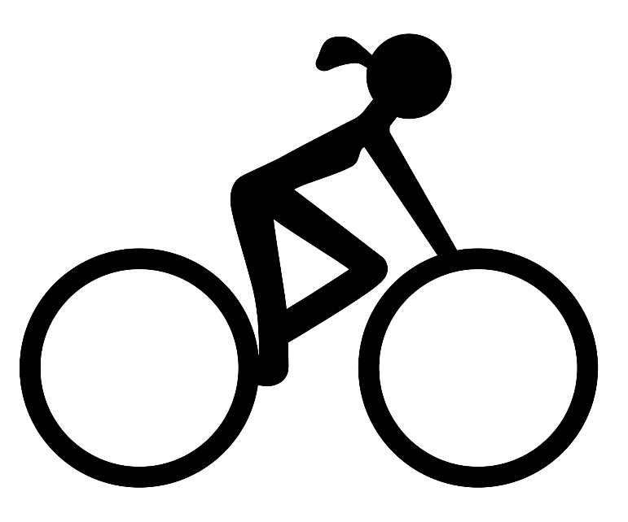
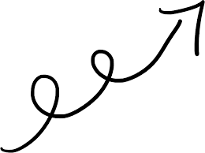
Carpool to Biking
Notes:
Let’s consider a scenario based on an actual example of a commuter changing their habit – I’ve added some details to help us work through how a habit could intentionally be changed using the tool we are learning today!
Carolyn was riding 14 miles to work every day in a carpool, but noticed an uptick in traffic that was making her commute longer. She was frustrated with the traffic and already a pretty good bicyclist, but she was worried about riding her bike home uphill. Also, her kids were demanding the family car more often as they reached driving age, which meant a lot of juggling.
Carolyn didn’t have much trouble identifying what she wanted to change: she wanted to spend less time commuting and free up the car by swapping some of her trips for bicycling. She knew the bike trip was often faster on the way to work and that she felt good when she rode the bike, especially in good weather.
But Carolyn was in the habit of riding in the carpool to and from work. Let’s see how examining her habits could have helped her to plan a change in her commute! We will simplify this just a little and focus on the commute to work because the habits in the morning and evening actually may be very different!

Slide 27
What’s a Routine?
Automatic behavior we don’t even think about.
Physical routines: walking to the bus stop every morning
Cognitive routines: remembering to pack a lunch so you don’t have to drive to a restaurant
Emotional routines: looking forward to the enjoyment of riding a bike to work
Notes:
In the habit loop model of how a habit works, the routine is that action that we are trying to change. Your routine might be a thing you always do, a thing you always think or a thing you always feel.

Slide 28
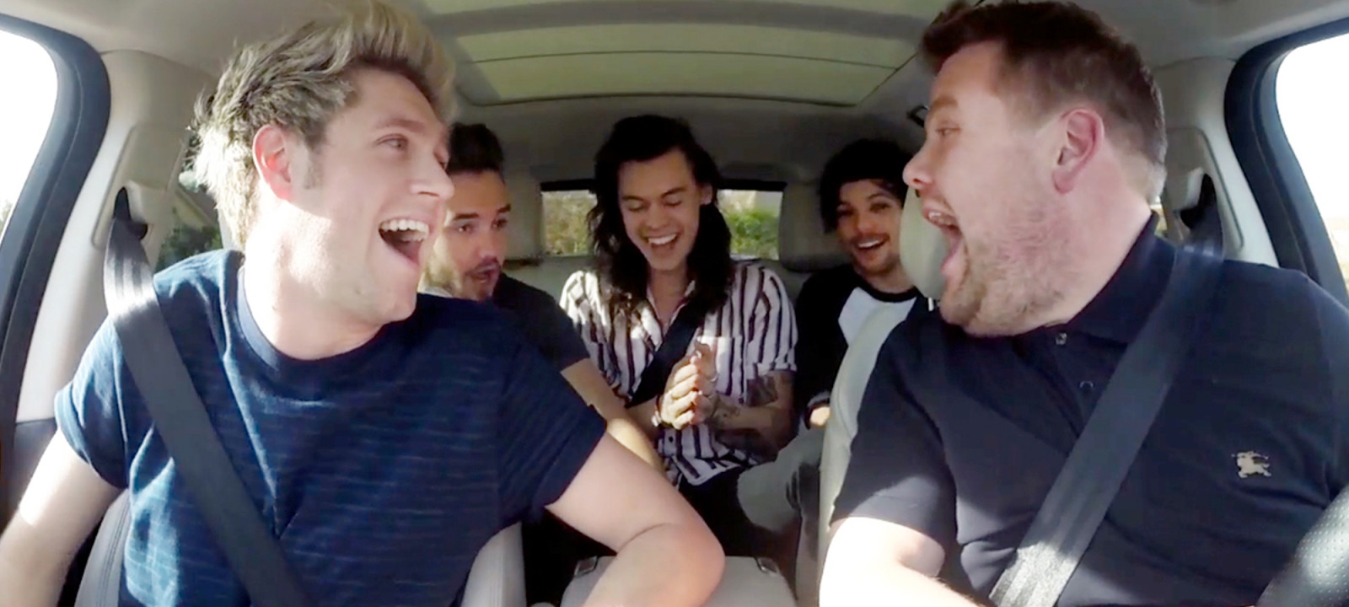
What is the routine with riding in a carpool to work?

Slide 29
What’s a Cue?
A signal to the brain that it’s time to go into automatic mode
Can be internal (hunger, fatigue) or external (a smell or sound)
The company we keep can cue us to act certain ways
Specific locations can also serve as behavioral cues
Notes:
A cue is the trigger that gets us started on our habit. Have you heard of Pavlov’s dogs? They responded to the cue of the bell with a habitual response of salivation and craving food.
While not all habits rely on such a strong biological reaction, they do all start with a cue. This cue is what signals to our brains that it is time to do the routine. Sometimes the cue is external – something you see, hear, feel, taste or smell. Sometimes it is a certain time of day or another activity you engage in. It might be connected to particular people or places. Or it can even be a thought or feeling entirely internal to yourself. In some cases, it might be multiple factors combined.

Slide 30
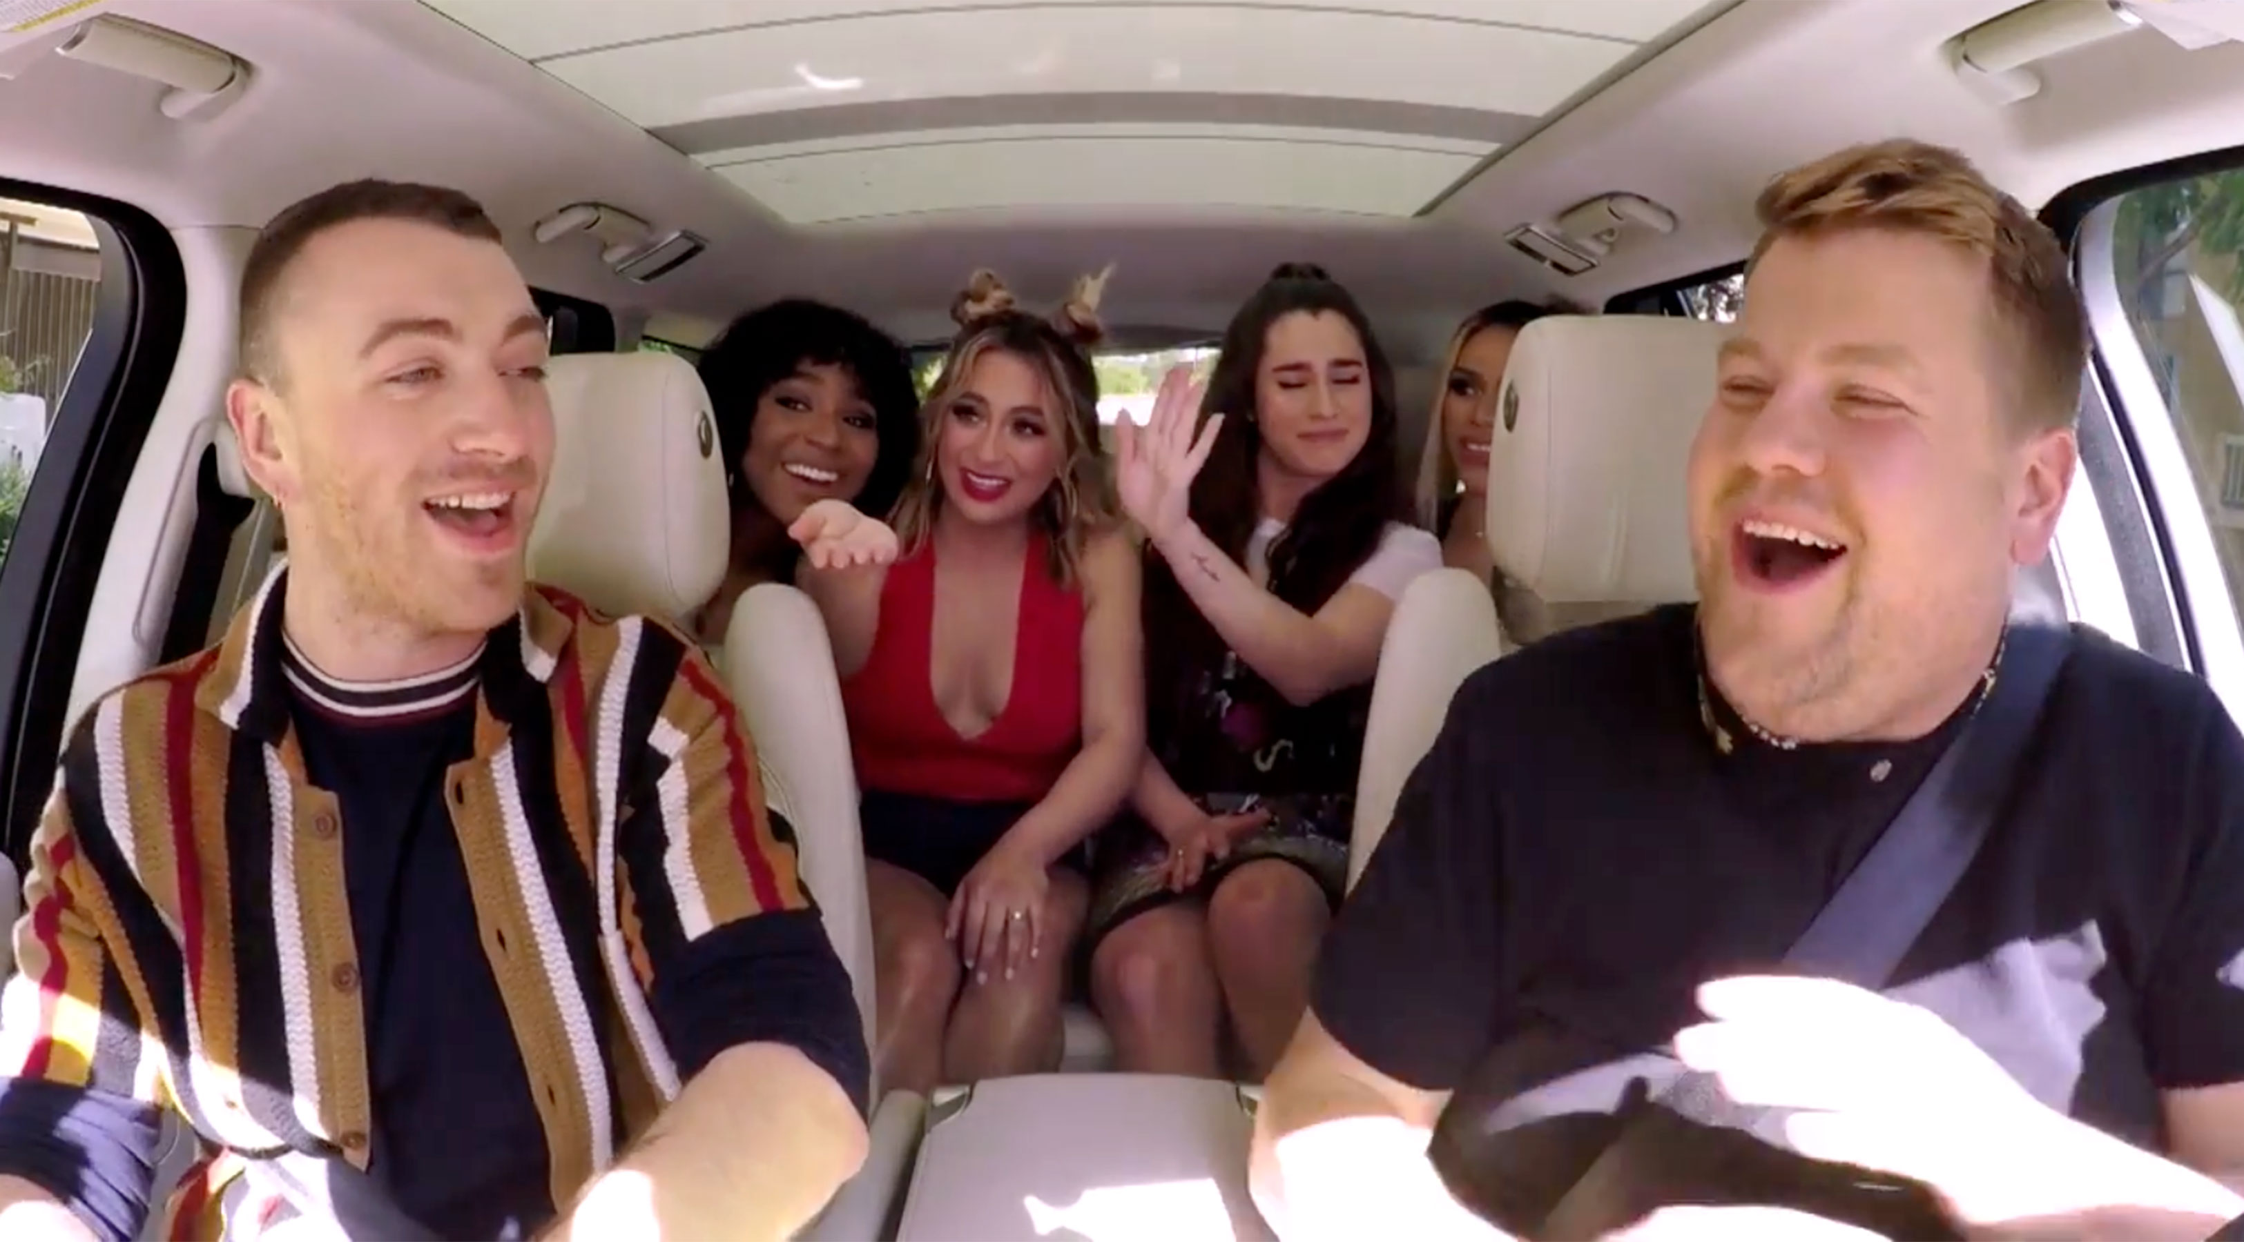
What are the cues for carpooling to work?

Slide 31
Craving & Reward
We remember the routine because we have received a reward in the past
Physical reward: losing weight as a result of adding more walking to my day
Cognitive reward: chatting with friends on the train about last night’s episode of That TV Show
Emotional reward: realizing that bikes are a fun way to get around
Notes:
We’ve identified what we do and when we do it.
But why do we do the same things every time we receive the same cue? One of the reasons lies in how our brains perceive rewards.
A good way to think about this is food. Many of us have food habits, like drinking coffee or tea first thing in the morning like I do. What kind of rewards does a steaming cup of coffee or tea give us in the morning?
Physical rewards are often the most obvious, but we can identify emotional and cognitive rewards as well. All of them cause the same positive reinforcement of the habit in our brain. Essentially, the reward helps us to remember that we got something good for responding to the cue appropriately.
Cravings play a role in further cementing these habits as well. Food cravings are again the easiest to grasp right away – we often crave coffee for that caffiene boost or sugar rush. But we can have emotional and cognitive cravings as well. The more often a craving is satisfied by responding to a cue with a routine that produces a reward, the more our brains become hardwired to practice this routine each time the cue let’s us know there is an opportunity for reward and satisfaction. Given enough practice, that loop becomes a habit that we don’t even think about.

Slide 32
What are the rewards for carpooling? What cravings might it satisfy?

Slide 33
The Golden Rule of
Habit Change
To change a habit, it is important to
keep the cue & the reward;
insert a new routine
into the habit loop.
Notes:
Now that we’ve identified our current habit loop – either one we want to change or one that we are going to use to form a new habit – we need to know the golden rule of habit change.
Because it is the cue and the reward that drive our habits and help us encode them in our long term instinctual memory instead of our processing mind, we want to use those powerful motivators as much as possible to help us change the routine.

Slide 34
What options do we have for changing the carpooling habit?
Notes:
Review what we have added in for each part of the habit loop on whiteboard or pad.
What are some ways we could change the routines here while still keeping the cues, the rewards, and satisfying the cravings?

Slide 35
Some ideas I had…
If the CUE is the carpool driver honking the horn, ask your ride not to come at all on one day of the week.
Stack in a new CUE to ride your bike – put your helmet next to the coffeepot as a reminder.
Find a riding partner for part of the trip to help meet the social CRAVING.
Celebrate the REWARD of feeling good when you ride!

Slide 36
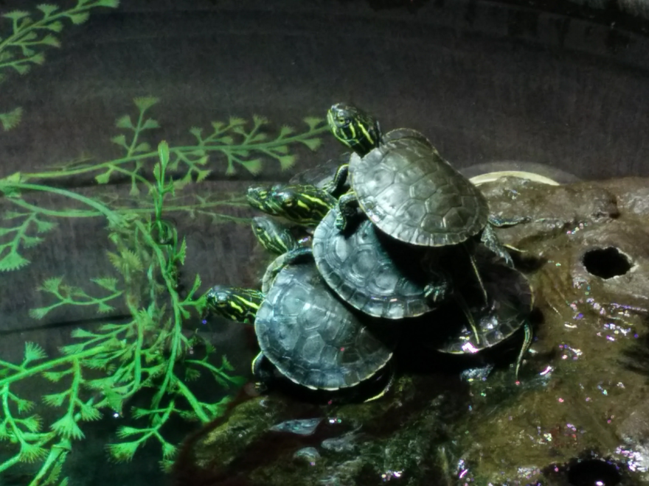
For New Habits, Try Stacking
Add a new habit before or after the cue, routine or reward of an existing habit
It’s a short-cut: you are hacking into a habit you already have
Less prefrontal cortex work / practice to by attaching to an amygdala memory than to form a new one

Slide 37
The habit loop is the same for new habits:
Identify desired routine first: “I want to start walking more as part of my commute by train.”
Identify an existing cue & habit: “Right now, I start to get my things together to leave the train two stops before my destination.”
Identify a reward: “I do that so that I don’t feel rushed and crowded when the train stops.”
Stack the new routine on the current cue: “When I get up two stops early, I am actually ready by the next stop. I will get off there and walk to work. Walking to work will reward me by feeling even less crowded and rushed.”

Slide 38
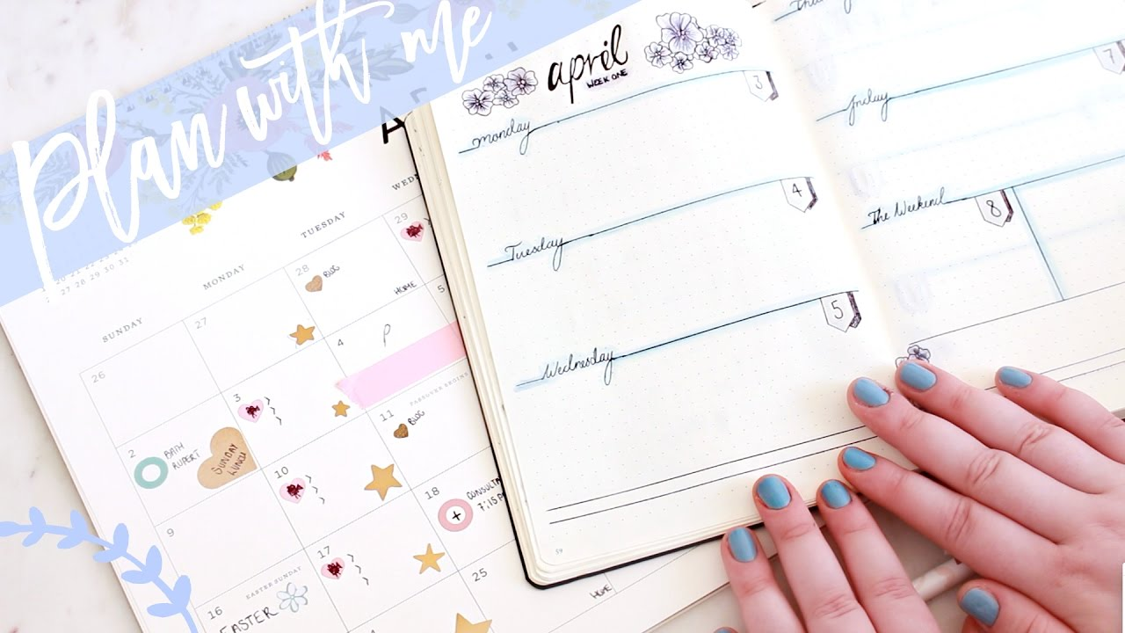
Let’s spend some time working on a habit YOU want to change…
Notes:
Time permitting

Slide 39
Next steps for educators
Build awareness
Teach skills
Reinforce skills, change
Celebrate change!
Notes:
There are a few key take-aways for those of us teaching habit change as a tool for making an impact:
Although raising awareness and teaching skills isn’t enough, it is necessary, so don’t forget to include those elements. We omitted awareness raising here because this is a highly motivated group with more awareness than usual. I ordinarily cover the reasons why Washington County is improving our internal operations.
You can’t skip skill building either. This presentation focused on the skill of changing a habit, and hopefully you’ve learned some effective tools for that. If I use habit change as a tool for teaching a specific sustainability practice, though, I tend to offer more concrete examples, tools and shortcuts to help support people.
One of the powerful things about teaching how to change a habit is that individuals identify the best ways for them to make change and how to practice that change. Often, there is little to no followup after a workshop or educational event. Be sure to build in ways for people to follow up with what they have learned. These can include making a written plan/pledge in class to take home, using a tracking tool or website to log their success, or contacting you for more information. Often, I will follow up with groups to see how things are going for them at planned intervals after the training using emails, calls or drop-by visits in the office. Design what works best for your resources and your audience.
Celebrate success! Show casing the real hurdles and successes of ordinary people who are making a change helps motivate others and make change more accessible. It also encourages people to try new things – don’t you feel great when you’ve changed a habit and other notice? What could be more motivating to take on something new? Celebrating change also supports a culture of change in a community or organization, leading to innovation and norming around making new choices.

Slide 40
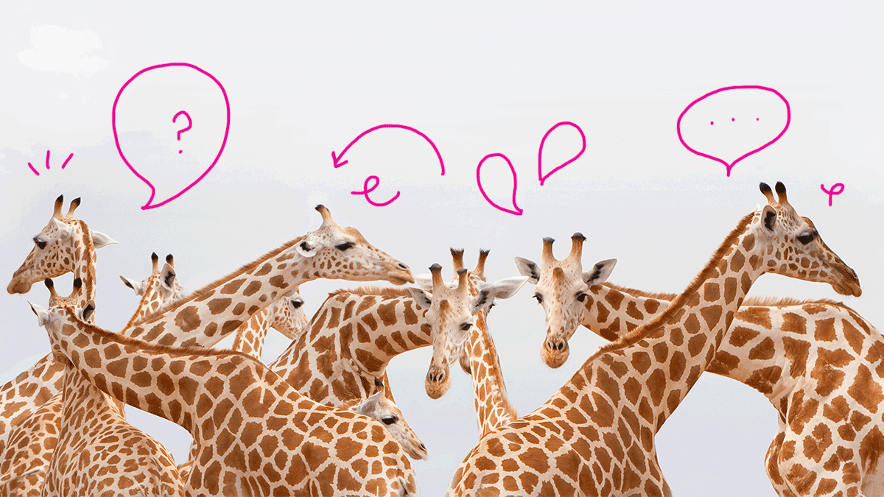
Questions?
Notes:
If we have time, we can discuss some of the habits you selected and work on some of your thoughts for changing them!

Slide 42
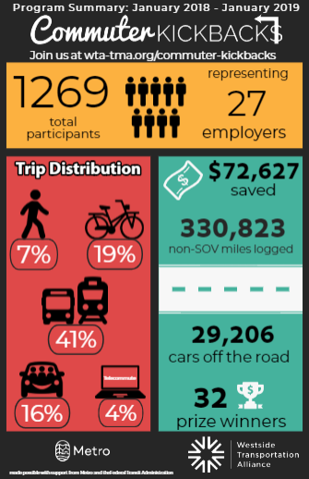
A look back at 2018….

Slide 43
2019 Program Updates
Register for DriveLessConnect.com
Log 4 days per month when you commute without driving alone
An non-drive alone commute includes:
Biking
Walking
Taking public transit
Carpool or vanpool
Ridesharing (Lyft, ReachNow, Car2Go)
Telecommuting
Compressed work week

Slide 44
Up your odds!
Log 8 or more days per month when you commute without driving alone to DOUBLE your chances of winning
Submit a commute story and photo using our online form and get TWO extra entries
Follow us on Facebook or subscribe to our newsletter to get one extra entry during the month you follow/sign-up and every month after

Slide 45
But wait…there’s more!
Bigger, better, and MORE prizes
Multi-modal “Grand Slam” Challenge in April!
Next week: Cupid’s Carpool Challenge

Slide 46
Log at least one day of carpool activity in Drive Less Connect for the chance to win a movie date night package!

